Slide 1
Syntax-Directed Translation

Slide 2
Introduction
Syntax directed translation is the notational framework for intermediate code generation.
It is an extension of context-free grammars.
It allows subroutines or semantic actions to be attached to the productions of a context-free grammar.
These subroutines generate intermediate code when called at appropriate times by a parser for that grammar.

Slide 3
Intermediate code generation
Intermediate codes are machine independent codes, but they are close to machine instructions.
The given program in a source language is converted to an equivalent program in an intermediate language by the intermediate code generator.

Slide 4
Intermediate language can be many different languages, and the designer of the compiler decides this intermediate language.
syntax trees can be used as an intermediate language.
postfix notation can be used as an intermediate language.
three-address code (Quadruples) can be used as an intermediate language
we will use quadruples to discuss intermediate code generation
quadruples are close to machine instructions, but they are not actual machine instructions.

Slide 5
The output action
Computation of values for variables
The generation of intermediate code
Printing error message
Placement of value in a table
The value associated with a grammar symbol is called a translation of that symbol.
The translation fields of a grammar symbol X with names like X.VAL, X.TRUE, X.CODE

Slide 6
two basic issues
In designing an intermediate-code generator, there are two basic issues:
Decide what intermediate code we should generate
Implement an algorithm for generating this code.

Slide 7
Syntax-Directed Definitions
A SDD is a context-free grammar together with attributes and rules.
Attributes may be of any kind:
Numbers, types, table references, or strings, for instance.
It is a CFG grammar augmented with:
“Attributes” (assigned to each grammar symbol).
Semantic Rules (associated to each production involving the Attributes of the symbols in the production).
Attributes can be synthesized or inherited.

Slide 8
The production and semantic actions
E → E + E is written with semantic action as below
E → E⁽¹⁾+ E⁽²⁾ {E.VAL → E⁽¹⁾.VAL+ E⁽²⁾.VAL}
The semantic actions is enclosed in braces and it appears after the production.
The terminal symbol + in the production is translated into its usual meaning by the semantic rule.
The production with several instances of the same symbol on the right, we distinguish the symbols with superscripts.

Slide 9
Types of translation
Synthesized translation
Inherited translation

Slide 10
Synthesized translation
The value of the non-terminal on the LHS of the production as a function of the translations of the non-terminals on the RHS.
Such a translation is called as synthesized translation.
ie., left is dependent on the right.
E → E⁽¹⁾+ E⁽²⁾ {E.VAL → E⁽¹⁾.VAL+ E⁽²⁾.VAL}

Slide 11
Inherited translation
The translation of a non-terminal on the RHS of the production is defined in terms of a translation of the non-terminal on the left.
Such a translation is called an inherited translation.
A → XYZ {Y.VAL := 2 * A.VAL}

Slide 12
tips
Terminals have only synthesized attributes whose values are provided by the lexical analyzer.
The start non-terminal typically has no inherited attributes.

Slide 13
Translation on the parse trees
Consider the syntax-directed translation for a desk-calculator
Production | Semantic Actions
E → E⁽¹⁾+ E⁽²⁾ | {E.VAL := E⁽¹⁾.VAL+ E⁽²⁾.VAL}
E → digit | {E.VAL := digit}
Digit → 0 | 1|..|9

Slide 14
Construct the parse tree for the string 2 + 3 + 4
E
E
E
E
E
+
+
4
2
3

Slide 15
Construct the parse tree for the string 2 + 3 + 4
E
E.Val = 9
E
E
+
E
E
E.Val = 5
+
E
E.Val = 4
E
4
E
+
E
E.Val = 2
+
E
E.Val = 3
4
2
3
2
3
Simple parse tree
Complete parse tree

Slide 16
Fig. 5.6. E.val is synthesized from E₁.val and E₂.val

Slide 17
Example of a Syntax-Directed Definition
Grammar symbols: L, E, T, F, n , + , * ,( , ) , digit
Non-terminals E, T, F have an attribute called val
Terminal digit has an attribute called lexval
The value for lexval is provided by the lexical analyzer.
PRODUCTION SEMANTIC RULE
S → E $ { print(E.val) }
E → E⁽¹⁾ + E⁽²⁾ { E.val = E⁽¹⁾.val + E⁽²⁾.val }
E → E⁽¹⁾ * E⁽²⁾ { E.val = E⁽¹⁾.val * E⁽²⁾.val }
E → (E⁽¹⁾) { E.val = E⁽¹⁾.val }
E → I { E.val = I.val }
I → I⁽¹⁾ digit { I.val = 10 * I⁽¹⁾.val + lexval }
I → digit { I.val = lexval }

Slide 18
23 * 5 + 4
S
E.Val=119
E
E.Val=115
$
E
+
E
E.Val=4
E.Val=23
E
*
E
E.Val=5
I
I.Val=4
digit
/
I.Val=23
I
I.Val=5
LEXVAL = 4
I.Val=3
I
digit
digit
LEXVAL = 3
LEXVAL = 5
digit
LEXVAL = 2

Slide 19
Example of a Syntax-Directed Definition
Grammar symbols: L, E, T, F, n , + , * ,( , ) , digit
Non-terminals E, T, F have an attribute called val
Terminal digit has an attribute called lexval
The value for lexval is provided by the lexical analyzer.
PRODUCTION SEMANTIC RULE
L → E n print(E.val)
E → E₁ + T E.val = E₁.val + T.val
E → T E.val = T.val
T → T₁ * F T.val = T₁.val * F.val
T → F T.val = F.val
F → (E) F.val = E.val
F → digit F.val = digit .lexval

Slide 20
Fig. 5.2. Syntax-directed definition of a simple desk calculator
Production | Semantic Rules
L → E n | print ( E.val )
E → E₁ + T | E.val := E₁.val + T.val
E → T | E.val := T.val
T → T₁ * F | T.val := T₁.val + F.val
T → F | T.val := F.val
F → ( E ) | F.val := E.val
F → digit | F.val := digit.lexval

Slide 21
Fig. 5.3. Annotated parse tree for 3*5+4n.

Slide 22
Fig. 5.4. Syntax-directed definition with inherited attribute L.in.
Production | Semantic Rules
D → T L | L.in := T.type
T → int | T.type := integer
T → real | T.type := real
L → L₁ , id | L₁.in := L.in addtype ( id.entry , L.in )
L → id | addtype ( id.entry , L.in )

Slide 23
Fig. 5.5. Parse tree with inherited attribute in at each node labeled L.

Slide 24
Draw the Tree
Example real id₁, id₂ , id₃
D
addtype(id₃,real)
L
in=real
addtype(id₂,real)
L
in=real
T
type=real
addtype(id₁,real)
L
in=real
id
entry=id₁
,
id
entry=id₂
,
id
entry=id₃
real

Slide 25
Three-address code
A more common representation is THREE-ADDRESS CODE .
Three address code is close to assembly language, making machine code generation easier.
Three address has statements of the form
x := y op z
To get an expression like x + y * z, we introduce TEMPORARIES:
t1 := y * z
t2 := x + t1
Three address is easy to generate from syntax trees. We associate a temporary with each interior tree node.

Slide 26
Three Address Code
Statements of general form x:=y op z
No built-up arithmetic expressions are allowed.
As a result, x:=y + z * w should be represented as t₁:=z * w t₂:=y + t₁ x:=t₂
Observe that given the syntax-tree or the dag of the graphical representation we can easily derive a three address code for assignments as above.
In fact three-address code is a linearization of the tree.
Three-address code is useful: related to machine-language/ simple/ optimisable.

Slide 27
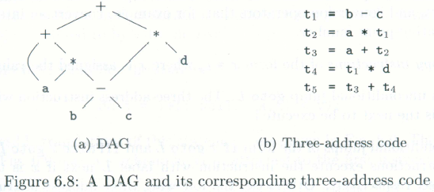
6.2 Three-Address Code
In three-address code, there is at most one operator on the right side of an instruction; that is, no built-up arithmetic expressions are permitted.
x+y*z ⇒ t₁ = y * z
t₂ = x + t₁
Example 6.4:

Slide 28
Types of Three Address code statements
Assignment statements of the form x := y op z, where op is a binary arithmetic or logical operation.
Assignment statements of the form x := op Y, where op is a unary operator, such as unary minus, logical negation
Copy statements of the form x := y, which assigns the value of y to x.
Unconditional statements goto L, which means the statement with label L is the next to be executed.
Conditional jumps, such as if x relop y goto L, where relop is a relational operator (<, =, >=, etc) and L is a label. (If the condition x relop y is true, the statement with label L will be executed next.)

Slide 29
Types of Three Address Code statements
Statements param x and call p, n for procedure calls, and return y, where y represents the (optional) returned value. The typical usage: p(x1, …, xn)
param x1
param x2
…
param xn
call p, n
Index assignments of the form x := y[i] and x[i] := y. The first sets x to the value in the location i memory units beyond location y. The second sets the content of the location i unit beyond x to the value of y.
Address and pointer assignments:
x := &y
x := *y
*x := y

Slide 30
Three Address Code implementation
The main representation is QUADRUPLES (structs containing 4 fields)
OP: the operator
ARG1: the first operand
ARG2: the second operand
RESULT: the destination

Slide 31
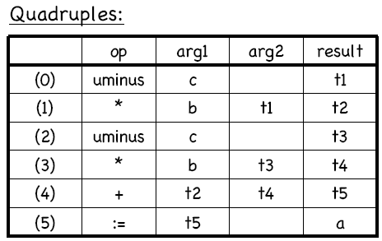
Three Address Code implementation
Code:
a := b * -c + b * -c
Three Address Code:
t1 := -c
t2 := b * t1
t3 := -c
t4 := b * t3
t5 := t2 + t4
a := t5

Slide 32
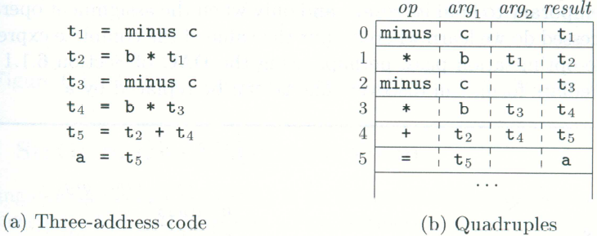
6.2.2 Quadruples
Three-address instructions can be implemented as objects or as record with fields for the operator and operands.
Three such representations
Quadruple, triples, and indirect triples
A quadruple (or quad) has four fields: op, arg₁, arg₂, and result.
Example 6.6:

Slide 33
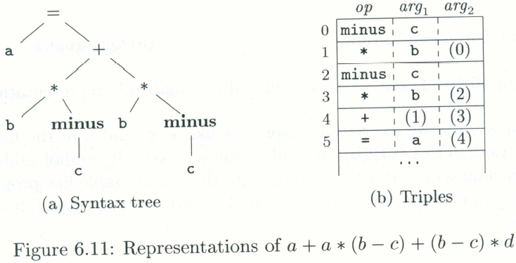
6.2.3 Triples
A triple has only three fields: op, arg₁, and arg₂
Using triples, we refer to the result of an operation x op y by its position, rather by an explicit temporary name.
Example 6.7:

Slide 34
Implementations of 3-address statements, II
 | op | arg1 | arg2
(0) | uminus | c
(1) | * | b | (0)
(2) | uminus | c
(3) | * | b | (2)
(4) | + | (1) | (3)
(5) | assign | a | (4)
Triples
t₁:=- c
t₂:=b * t₁
t₃:=- c
t₄:=b * t₃
t₅:=t₂ + t₄
a:=t₅
Temporary names are not entered into the symbol table.

Slide 35
Other types of 3-address statements
e.g. ternary operations like x[i]:=y x:=y[i]
require two or more entries. e.g.
 | op | arg1 | arg2
(0) | [ ] = | x | i
(1) | assign | (0) | y
 | op | arg1 | arg2
(0) | [ ] = | y | i
(1) | assign | x | (0)

Slide 36
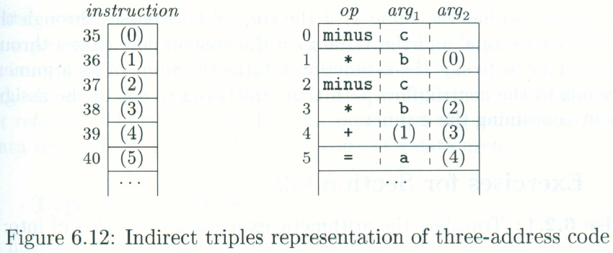
6.2.3 indirect Triples

Slide 37
Example
Three address code
t1 = minus c
t2 = b * t1
t3 = minus c
t4 = b * t3
t5 = t2 + t4
a = t5
b * minus c + b * minus c
Quadruples
Triples
Indirect Triples
op
arg1
arg2
result
op
arg1
arg2
op
op
arg1
arg2
minus
c
t1
0
minus
c
35
(0)
0
minus
c
*
b
t1
t2
1
*
b
(0)
36
(1)
1
*
b
(0)
minus
c
t3
2
minus
c
37
(2)
2
minus
c
*
b
t3
t4
3
*
b
(2)
38
(3)
3
*
b
(2)
+
t2
t4
t5
4
+
(1)
(3)
39
(4)
4
+
(1)
(3)
=
t5
a
5
=
a
(4)
40
(5)
5
=
a
(4)

Slide 38
6.2.1 Address and Instructions
Three-address code is built from two concepts: addresses and instructions.
An address can be one of the following:
A name
A constant
A compiler-generated temporary
A list of common three-address instruction forms:
Assignment instructions of the form x = y op z
Assignments of the for x = op y
Copy instructions of the form x = y
An unconditional jump goto L.
Conditional jumps of the form if x goto L and ifFalse x goto L
Conditional jumps such as if x relop y goto L
Procedure calls and returns
Indexed copy instructions of the form x=y[i] and x[i]=y
Address and pointer assignments of the form x = &y, x = *y, and *x = y

Slide 39
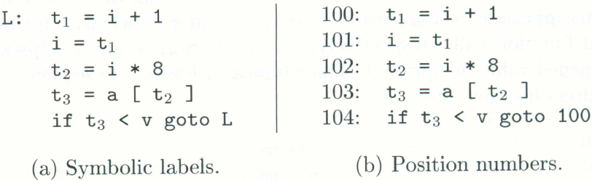
6.2.1 Address and Instructions
Example 6.5:
do i = i +1; while (a[i]<v);

Slide 40
Syntax-directed generation of Three Address Code
Idea: expressions get two attributes:
E.place: a name to hold the value of E at runtime
id.place is just the lexeme for the id
E.code: the sequence of 3AC statements implementing E
We associate temporary names for interior nodes of the syntax tree.
The function newtemp() returns a fresh temporary name on each invocation

Slide 41
Syntax-directed translation
For ASSIGNMENT statements and expressions, we can use this SDD:
Production Semantic Rules
S -> id := E S.code := E.code || gen( id.place ‘:=‘ E.place )
E -> E1 + E2 E.place := newtemp();
E.code := E1.code || E2.code ||
gen( E.place ‘:=‘ E1.place ‘+’ E2.place )
E -> E1 * E2 E.place := newtemp();
E.code := E1.code || E2.code ||
gen( E.place ‘:=‘ E1.place ‘*’ E2.place )
E -> - E1 E.place := newtemp();
E.code := E1.code || gen( E.place ‘:=‘ ‘uminus’ E1.place )
E -> ( E1 ) E.place := E1.place; E.code := E1.code
E -> id E.place := id.place; E.code := ‘’

Slide 42
6.4.1 Operations Within Expressions
Example 6.11:
a = b+ -c
t1 = minus
t2 = b + t1
a = t2

Slide 43
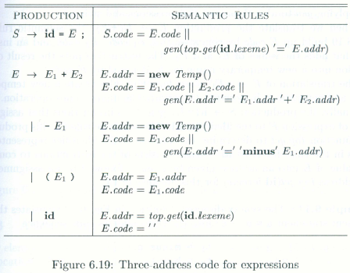

Slide 44
Intermediate Code Generation

Slide 45
Intermediate Code Generation
Forms of intermediate code vary from high level ...
Annotated abstract syntax trees
Directed acyclic graphs (common subexpressions are coalesced)
... to the low level Three Address Code
Each instruction has, at most, one binary operation
More abstract than machine instructions
No explicit memory allocation
No specific hardware architecture assumptions
Lower level than syntax trees
Control structures are spelled out in terms of instruction jumps
Suitable for many types of code optimization
Java bytecode VM (Virtual Machine) instructions have both:
Stack machine operations are lower level than Three Address Code.
But some operations require name lookups, and are higher level.

Slide 46
Three Address Code
Consists of a sequence of instructions, each instruction may have up to three addresses, prototypically t1 = t2 op t3
Addresses may be one of:
A name. Each name is a symbol table index. For convenience, we write the names as the identifier.
A constant.
A compiler-generated temporary. Each time a temporary address is needed, the compiler generates another name from the stream t1, t2, t3, etc.
Temporary names allow for code optimization to easily move instructions
At target-code generation time, these names will be allocated to registers or to memory.

Slide 47
Three Address Code Instructions
Symbolic labels will be used as instruction addresses for instructions that alter the flow of control. The instruction addresses of labels will be filled in later. L: t1 = t2 op t3
Assignment instructions: x = y op z
Includes binary arithmetic and logical operations
Unary assignments: x = op y
Includes unary arithmetic op (-) and logical op (!) and type conversion
Copy instructions: x = y
These may be optimized later.

Slide 48
Three Address Code Instructions
Unconditional jump: goto L
L is a symbolic label of an instruction
Conditional jumps: if x goto L and ifFalse x goto L
Left: If x is true, execute instruction L next
Right: If x is false, execute instruction L next
Conditional jumps: if x relop y goto L
Procedure calls. For a procedure call p(x1, …, xn) param x1 … param xn call p, n

Slide 49
Three Address Code Instructions
Indexed copy instructions: x = y[i] and x[i] = y
Left: sets x to the value in the location [i memory units beyond y] (in C)
Right: sets the contents of the location [i memory units beyond y] to x
Address and pointer instructions:
x = &y sets the value of x to be the location (address) of y.
x = *y, presumably y is a pointer or temporary whose value is a location. The value of x is set to the contents of that location.
*x = y sets the value of the object pointed to by x to the value of y.
In Java, all object variables store references (pointers), and Strings and arrays are implicit objects:
Object o = "some string object", sets the reference o to hold the address of this string. The String object itself is shared, not copied by value.
x = y[i], uses the implicit length-aware array object y; there is full object here, not just array contents.

Slide 50
Three Address Code Representation
Representations include quadruples (used here), triples and indirect triples.
In the quadruple representation, there are four fields for each instruction: op, arg1, arg2 and result.
Binary ops have the obvious representation
Unary ops don’t use arg2
Operators like param don’t use either arg2 or result
Jumps put the target label into result

Slide 51
Syntax-Directed Translation of Intermediate Code
Incremental Translation
Instead of using an attribute to keep the generated code, we assume that we can generate instructions into a stream of instructions
gen(<three address instruction>) generates an instruction
new Temp() generates a new temporary
lookup(top, id) returns the symbol table entry for id at the topmost (innermost) lexical level
newlabel() generates a new abstract label name

Slide 52
Translation of Expressions
Uses the attribute addr to keep the addr of the instruction for that nonterminal symbol.
S → id = E ; | Gen(lookup(top, id.text) = E.addr)
E → E1 + E2 | E.addr = new Temp() Gen(E.addr = E1.addr plus E2.addr)
| - E1 | E.addr = new Temp() Gen(E.addr = minus E1.addr)
| ( E1 ) | E.addr = E1.addr
| id | E.addr = lookup(top, id.text)

Slide 53
Boolean Expressions
Boolean expressions have different translations depending on their context
Compute logical values – code can be generated in analogy to arithmetic expressions for the logical operators
Alter the flow of control – boolean expressions can be used as conditional expressions in statements: if, for and while.
Control Flow Boolean expressions have two inherited attributes:
B.true, the label to which control flows if B is true
B.false, the label to which control flows if B is false
B.false = S.next means:
if B is false, Goto whatever address comes after instruction S is completed.
This would be used for S → if (B) S1 expansion
(in this case, we also have S1.next = S.next)

Slide 54
Short-Circuit Boolean Expressions
Some language semantics decree that boolean expressions have so-called short-circuit semantics.
In this case, computing boolean operations may also have flow-of-control Example: if ( x < 100 || x > 200 && x != y ) x = 0; Translation: if x < 100 goto L2 ifFalse x >200 goto L1 ifFalse x != y goto L1 L2: x = 0 L1: …

Slide 55
Flow-of-Control Statements
S → if ( B ) S1
| if ( B ) S1 else S2
| while ( B ) S1
if
B.Code
S1.Code
…
to B.true
to B.false
B.true
B.false
= S.next
if-else
B.Code
S1.Code
goto S.next
S2.code
…
to B.true
to B.false
B.true
B.False
S.Next
while
begin
B.true
B.false
= S.next
B.Code
S1.Code
goto begin
…
to B.true
to B.false

Slide 56
Flow-of-Control Translations
P → S | S.Next = newlabel() P.Code = S.code || label(S.next)
S → assign | S.Code = assign.code
S → if ( B ) S1 | B.True = newlabel() B.False = S1.next = S.next S.Code = B.code || label(B.true) || S1.code
S → if ( B ) S1 else S2 | B.True = newlabel(); b.false = newlabel(); S1.next = S2.next = S.next S.Code = B.code || label(B.true) || S1.code || gen (goto S.next) || label (B.false) || S2.code
S → while (B) S1 | Begin = newlabel(); B.True = newlabel(); B.False = S.next; S1.next = begin S.Code = label(begin) || B.code || label(B.true) || S1.code || gen(goto begin)
S → S1 S2 | S1.next = newlabel(); S2.next = S.next; S.Code = S1.code || label(S1.next) || S2.code
|| : Code
concatenation
operator

Slide 57
Control-Flow Boolean Expressions
B → B1 || B2 | B1.true = B.true; B1.false = newlabel(); B2.true = B.true; B2.false = B.false; B.Code = B1.code || label(B1.false) || B2.code
B → B1 && B2 | B1.true = newlabel(); B1.false = B.false B2.true = B.true; B2.false = B.false B.Code = B1.code || label(B1.true) || B2.code
B → ! B1 | B1.True = B.false; B1.false = B.true; B.Code = B1.code
B →E1 rel E2 | B.Code = E1.code || E2.code || gen( if E1.addr relop E2.addr goto B.true) || gen( goto B.false)
B → true | B.Code = gen(goto B.true)
B → false | B.Code = gen(goto B.false)

Slide 58
Avoiding Redundant Gotos, Backpatching
Use ifFalse instructions where necessary
Also use attribute value “fall” to mean to fall through where possible, instead of generating goto to the next expression
The abstract labels require a two-pass scheme to later fill in the addresses
This can be avoided by instead passing a list of addresses that need to be filled in, and filling them as it becomes possible. This is called backpatching.

Slide 59
Java Bytecode, Virtual Machine Instructions
Java bytecode is an intermediate representation.
It uses a stack-machine, which is generally at a lower level than a three-address code.
But it also has some conceptually high-level instructions that need table lookups for method names, etc.
The lookups are needed due to dynamic class loading in Java:
If class A uses class B, the reference can only compile if you have access to B.class (or if your IDE can compile B.java to its B.class).
In runtime, A.class and B.class hold bytecode for class A and B.
Loading A does not automatically load B. B is loaded only if it is needed.
Before B is loaded, its method signatures (interfaces) are known but implementation may change; there is no known address-of-method.

Slide 60
Displaying Bytecode
From command line, you can use this command to see the bytecode:
javap -private -c MyClass
You need to have access to MyClass.class file
There are many options to see more information about local variables, where they are accessed in bytecode, etc.
Important: Stack machine stack is empty after each full instruction.
Example: d = a + b * c
instruction stack description
iload_1 a get local var #2, a, push it into stack
iload_2 a,b push b into stack
iload_3 a,b,c push c into stack (now, c is on top of stack)
imul a,x integer multiply top two elements, push result x=b*c
iadd y integer add top two elements, push result y=a*x
istore 4 -- pop and store top of stack to d

Slide 61
Method Call in Java Bytecode
Method calls need symbol lookup
Example: System.out.println(d);
18: getstatic #2; //Field java/lang/System.out:Ljava/io/PrintStream;
21: iload 4
23: invokevirtual #3; //Method java/io/PrintStream.println:(I)V
Java internal signature: Lmypkg.MyClass: object of MyClass, defined in package mypkg
Java internal signature: (I)V: takes integer, returns void
We will be focusing on MicroJava virtual machine instructions
Few instructions compared to full Java VM instructions
Simpler language features, less complicated
Same basic principles as Java VM in method calls, field access, etc.
But: Classes don't have methods in MicroJava

Slide 62
Three-Address Code (Quadraples)
A quadraple is:
x := y op z
where x, y and z are names, constants or compiler-generated temporaries; op is any operator.
But we may also the following notation for quadraples (much better notation because it looks like a machine code instruction)
op y,z,x
apply operator op to y and z, and store the result in x.
We use the term “three-address code” because each statement usually contains three addresses (two for operands, one for the result).

Slide 63
Three-Address Statements
Binary Operator: op y,z,result or result := y op z
where op is a binary arithmetic or logical operator. This binary operator is applied to y and z, and the result of the operation is stored in result.
Ex: add a,b,c
gt a,b,c
addr a,b,c
addi a,b,c
Unary Operator: op y,,result or result := op y
where op is a unary arithmetic or logical operator. This unary operator is applied to y, and the result of the operation is stored in result.
Ex: uminus a,,c
not a,,c
inttoreal a,,c

Slide 64
Three-Address Statements (cont.)
Move Operator: mov y,,result or result := y
where the content of y is copied into result.
Ex: mov a,,c
movi a,,c
movr a,,c
Unconditional Jumps: jmp ,,L or goto L
We will jump to the three-address code with the label L, and the execution continues from that statement.
Ex: jmp ,,L1 // jump to L1
jmp ,,7 // jump to the statement 7

Slide 65
Three-Address Statements (cont.)
Conditional Jumps: jmprelop y,z,L or if y relop z goto L
We will jump to the three-address code with the label L if the result of y relop z is true, and the execution continues from that statement. If the result is false, the execution continues from the statement following this conditional jump statement.
Ex: jmpgt y,z,L1 // jump to L1 if y>z
jmpgte y,z,L1 // jump to L1 if y>=z
jmpe y,z,L1 // jump to L1 if y==z
jmpne y,z,L1 // jump to L1 if y!=z
Our relational operator can also be a unary operator.
jmpnz y,,L1 // jump to L1 if y is not zero
jmpz y,,L1 // jump to L1 if y is zero
jmpt y,,L1 // jump to L1 if y is true
jmpf y,,L1 // jump to L1 if y is false

Slide 66
Three-Address Statements (cont.)
Procedure Parameters: param x,, or param x
Procedure Calls: call p,n, or call p,n
where x is an actual parameter, we invoke the procedure p with n parameters.
Ex: param x₁,,
param x₂,,
➔ p(x₁,...,x_{n})
param x_{n},,
call p,n,
f(x+1,y) ➔ add x,1,t1
param t1,,
param y,,
call f,2,

Slide 67
Three-Address Statements (cont.)
Indexed Assignments:
move y[i],,x or x := y[i]
move x,,y[i] or y[i] := x
Address and Pointer Assignments:
moveaddr y,,x or x := &y
movecont y,,x or x := *y

Slide 68
Syntax-Directed Translation into Three-Address Code
S → id := E S.code = E.code || gen(‘mov’ E.place ‘,,’ id.place)
E → E₁ + E₂ E.place = newtemp();
E.code = E₁.code || E₂.code || gen(‘add’ E₁.place ‘,’ E₂.place ‘,’ E.place)
E → E₁ * E₂ E.place = newtemp();
E.code = E₁.code || E₂.code || gen(‘mult’ E₁.place ‘,’ E₂.place ‘,’ E.place)
E → - E₁ E.place = newtemp();
E.code = E₁.code || gen(‘uminus’ E₁.place ‘,,’ E.place)
E → ( E₁ ) E.place = E₁.place;
E.code = E₁.code
E → id E.place = id.place;
E.code = null

Slide 69
Syntax-Directed Translation (cont.)
S → while E do S₁ S.begin = newlabel();
S.after = newlabel();
S.code = gen(S.begin “:”) || E.code ||
gen(‘jmpf’ E.place ‘,,’ S.after) || S₁.code ||
gen(‘jmp’ ‘,,’ S.begin) ||
gen(S.after ‘:”)
S → if E then S₁ else S₂ S.else = newlabel();
S.after = newlabel();
S.code = E.code ||
gen(‘jmpf’ E.place ‘,,’ S.else) || S₁.code ||
gen(‘jmp’ ‘,,’ S.after) ||
gen(S.else ‘:”) || S₂.code ||
gen(S.after ‘:”)

Slide 70
Translation Scheme to Produce Three-Address Code
S → id := E { p= lookup(id.name);
if (p is not nil) then emit(‘mov’ E.place ‘,,’ p)
else error(“undefined-variable”) }
E → E₁ + E₂ { E.place = newtemp();
emit(‘add’ E₁.place ‘,’ E₂.place ‘,’ E.place) }
E → E₁ * E₂ { E.place = newtemp();
emit(‘mult’ E₁.place ‘,’ E₂.place ‘,’ E.place) }
E → - E₁ { E.place = newtemp();
emit(‘uminus’ E₁.place ‘,,’ E.place) }
E → ( E₁ ) { E.place = E₁.place; }
E → id { p= lookup(id.name);
if (p is not nil) then E.place = id.place
else error(“undefined-variable”) }

Slide 71
Translation Scheme with Locations
S → id := { E.inloc = S.inloc } E
{ p = lookup(id.name);
if (p is not nil) then { emit(E.outloc ‘mov’ E.place ‘,,’ p); S.outloc=E.outloc+1 }
else { error(“undefined-variable”); S.outloc=E.outloc } }
E → { E₁.inloc = E.inloc } E₁ + { E₂.inloc = E₁.outloc } E₂
{ E.place = newtemp(); emit(E₂.outloc ‘add’ E₁.place ‘,’ E₂.place ‘,’ E.place); E.outloc=E₂.outloc+1 }
E → { E₁.inloc = E.inloc } E₁ + { E₂.inloc = E₁.outloc } E₂
{ E.place = newtemp(); emit(E₂.outloc ‘mult’ E₁.place ‘,’ E₂.place ‘,’ E.place); E.outloc=E₂.outloc+1 }
E → - { E₁.inloc = E.inloc } E₁
{ E.place = newtemp(); emit(E₁.outloc ‘uminus’ E₁.place ‘,,’ E.place); E.outloc=E₁.outloc+1 }
E → ( E₁ ) { E.place = E₁.place; E.outloc=E₁.outloc+1 }
E → id { E.outloc = E.inloc; p= lookup(id.name);
if (p is not nil) then E.place = id.place
else error(“undefined-variable”) }

Slide 72
Boolean Expressions
E → { E₁.inloc = E.inloc } E₁ and { E₂.inloc = E₁.outloc } E₂
{ E.place = newtemp(); emit(E₂.outloc ‘and’ E₁.place ‘,’ E₂.place ‘,’ E.place); E.outloc=E₂.outloc+1 }
E → { E₁.inloc = E.inloc } E₁ or { E₂.inloc = E₁.outloc } E₂
{ E.place = newtemp(); emit(E₂.outloc ‘and’ E₁.place ‘,’ E₂.place ‘,’ E.place); E.outloc=E₂.outloc+1 }
E → not { E₁.inloc = E.inloc } E₁
{ E.place = newtemp(); emit(E₁.outloc ‘not’ E₁.place ‘,,’ E.place); E.outloc=E₁.outloc+1 }
E → { E₁.inloc = E.inloc } E₁ relop { E₂.inloc = E₁.outloc } E₂
{ E.place = newtemp();
emit(E₂.outloc relop.code E₁.place ‘,’ E₂.place ‘,’ E.place); E.outloc=E₂.outloc+1 }

Slide 73
Translation Scheme(cont.)
S → while { E.inloc = S.inloc } E do
{ emit(E.outloc ‘jmpf’ E.place ‘,,’ ‘NOTKNOWN’);
S₁.inloc=E.outloc+1; } S₁
{ emit(S₁.outloc ‘jmp’ ‘,,’ S.inloc);
S.outloc=S₁.outloc+1;
backpatch(E.outloc,S.outloc); }
S → if { E.inloc = S.inloc } E then
{ emit(E.outloc ‘jmpf’ E.place ‘,,’ ‘NOTKNOWN’);
S₁.inloc=E.outloc+1; } S₁ else
{ emit(S₁.outloc ‘jmp’ ‘,,’ ‘NOTKNOWN’);
S₂.inloc=S₁.outloc+1;
backpatch(E.outloc,S₂.inloc); } S₂
{ S.outloc=S₂.outloc;
backpatch(S₁.outloc,S.outloc); }

Slide 74
Three Address Codes - Example
x:=1; 01: mov 1,,x
y:=x+10; 02: add x,10,t1
while (x<y) { ➔ 03: mov t1,,y
x:=x+1; 04: lt x,y,t2
if (x%2==1) then y:=y+1; 05: jmpf t2,,17
else y:=y-2; 06: add x,1,t3
} 07: mov t3,,x
08: mod x,2,t4
09: eq t4,1,t5
10: jmpf t5,,14
11: add y,1,t6
12: mov t6,,y
13: jmp ,,16
14: sub y,2,t7
15: mov t7,,y
16: jmp ,,4
17:

Slide 75
Arrays
Elements of arrays can be accessed quickly if the elements are stored in a block of consecutive locations.
A one-dimensional array A:
base_{A} low i width
base_{A} is the address of the first location of the array A,
width is the width of each array element.
low is the index of the first array element
location of A[i] ➔ base_{A}+(i-low)*width
 | … |  | …

Slide 76
Arrays (cont.)
base_{A}+(i-low)*width
can be re-written as i*width + (base_{A}-low*width)
should be computed at run-time can be computed at compile-time
So, the location of A[i] can be computed at the run-time by evaluating the formula i*width+c where c is (base_{A}-low*width) which is evaluated at compile-time.
Intermediate code generator should produce the code to evaluate this formula i*width+c (one multiplication and one addition operation).

Slide 77
Two-Dimensional Arrays
A two-dimensional array can be stored in
either row-major (row-by-row) or
column-major (column-by-column).
Most of the programming languages use row-major method.
Row-major representation of a two-dimensional array:
row₁ row₂ row_{n}

Slide 78
Two-Dimensional Arrays (cont.)
The location of A[i₁,i₂] is
base_{A}+ ((i₁-low₁)*n₂+i₂-low₂)*width
base_{A} is the location of the array A.
low₁ is the index of the first row
low₂ is the index of the first column
n₂ is the number of elements in each row
width is the width of each array element
Again, this formula can be re-written as
((i₁*n₂)+i₂)*width + (base_{A}-((low₁*n₁)+low₂)*width)
should be computed at run-time can be computed at compile-time

Slide 79
Multi-Dimensional Arrays
In general, the location of A[i₁,i₂,...,i_{k}] is
(( ... ((i₁*n₂)+i₂) ...)*n_{k}+i_{k})*width + (base_{A}-((...((low₁*n₁)+low₂)...)*n_{k}+low_{k})*width)
So, the intermediate code generator should produce the codes to evaluate the following formula (to find the location of A[i₁,i₂,...,i_{k}]) :
(( ... ((i₁*n₂)+i₂) ...)*n_{k}+i_{k})*width + c
To evaluate the (( ... ((i₁*n₂)+i₂) ...)*n_{k}+i_{k} portion of this formula, we can use the recurrence equation:
e₁ = i₁
e_{m} = e_{m-1} * n_{m} + i_{m}

Slide 80
Translation Scheme for Arrays
If we use the following grammar to calculate addresses of array elements, we need inherited attributes.
L → id | id [ Elist ]
Elist → Elist , E | E
Instead of this grammar, we will use the following grammar to calculate addresses of array elements so that we do not need inherited attributes (we will use only synthesized attributes).
L → id | Elist ]
Elist → Elist , E | id [ E

Slide 81
Translation Scheme for Arrays (cont.)
S → L := E { if (L.offset is null) emit(‘mov’ E.place ‘,,’ L.place)
else emit(‘mov’ E.place ‘,,’ L.place ‘[‘ L.offset ‘]’) }
E → E₁ + E₂ { E.place = newtemp();
emit(‘add’ E₁.place ‘,’ E₂.place ‘,’ E.place) }
E → ( E₁ ) { E.place = E₁.place; }
E → L { if (L.offset is null) E.place = L.place)
else { E.place = newtemp();
emit(‘mov’ L.place ‘[‘ L.offset ‘]’ ‘,,’ E.place) } }

Slide 82
Translation Scheme for Arrays (cont.)
L → id { L.place = id.place; L.offset = null; }
L → Elist ]
{ L.place = newtemp(); L.offset = newtemp();
emit(‘mov’ c(Elist.array) ‘,,’ L.place);
emit(‘mult’ Elist.place ‘,’ width(Elist.array) ‘,’ L.offset) }
Elist → Elist₁ , E
{ Elist.array = Elist₁.array ; Elist.place = newtemp(); Elist.ndim = Elist₁.ndim + 1;
emit(‘mult’ Elist₁.place ‘,’ limit(Elist.array,Elist.ndim) ‘,’ Elist.place);
emit(‘add’ Elist.place ‘,’ E.place ‘,’ Elist.place); }
Elist → id [ E
{Elist.array = id.place ; Elist.place = E.place; Elist.ndim = 1; }

Slide 83
Translation Scheme for Arrays – Example1
A one-dimensional double array A : 5..100
➔ n₁=95 width=8 (double) low₁=5
Intermediate codes corresponding to x := A[y]
mov c,,t1 // where c=base_{A}-(5)*8
mult y,8,t2
mov t1[t2],,t3
mov t3,,x

Slide 84
Translation Scheme for Arrays – Example2
A two-dimensional int array A : 1..10x1..20
➔ n₁=10 n₂=20 width=4 (integers) low₁=1 low₂=1
Intermediate codes corresponding to x := A[y,z]
mult y,20,t1
add t1,z,t1
mov c,,t2 // where c=base_{A}-(1*20+1)*4
mult t1,4,t3
mov t2[t3],,t4
mov t4,,x

Slide 85
Translation Scheme for Arrays – Example3
A three-dimensional int array A : 0..9x0..19x0..29
➔ n₁=10 n₂=20 n₃=30 width=4 (integers) low₁=0 low₂=0 low₃=0
Intermediate codes corresponding to x := A[w,y,z]
mult w,20,t1
add t1,y,t1
mult t1,30,t2
add t2,z,t2
mov c,,t3 // where c=base_{A}-((0*20+0)*30+0)*4
mult t2,4,t4
mov t3[t4],,t5
mov t5,,x

Slide 86
Declarations
P → M D
M → € { offset=0 }
D → D ; D
D → id : T { enter(id.name,T.type,offset); offset=offset+T.width }
T → int { T.type=int; T.width=4 }
T → real { T.type=real; T.width=8 }
T → array[num] of T₁ { T.type=array(num.val,T₁.type);
T.width=num.val*T₁.width }
T → ↑ T₁ { T.type=pointer(T₁.type); T.width=4 }
where enter crates a symbol table entry with given values.

Slide 87
Nested Procedure Declarations
For each procedure we should create a symbol table.
mktable(previous) – create a new symbol table where previous is the parent symbol table of this new symbol table
enter(symtable,name,type,offset) – create a new entry for a variable in the given symbol table.
enterproc(symtable,name,newsymbtable) – create a new entry for the procedure in the symbol table of its parent.
addwidth(symtable,width) – puts the total width of all entries in the symbol table into the header of that table.
We will have two stacks:
tblptr – to hold the pointers to the symbol tables
offset – to hold the current offsets in the symbol tables in tblptr stack.

Slide 88
Nested Procedure Declarations
P → M D { addwidth(top(tblptr),top(offset)); pop(tblptr); pop(offset) }
M → € { t=mktable(nil); push(t,tblptr); push(0,offset) }
D → D ; D
D → proc id N D ; S
{ t=top(tblptr); addwidth(t,top(offset));
pop(tblptr); pop(offset);
enterproc(top(tblptr),id.name,t) }
D → id : T { enter(top(tblptr),id.name,T.type,top(offset));
top(offset)=top(offset)+T.width }
N → € { t=mktable(top(tblptr)); push(t,tblptr); push(0,offset) }

